Slide 1


Mining of social media data and the impact of COVID-19 on other health diseases in Uganda
Agnes Kiragga, PhD
Infectious Diseases Institute
African Center of Excellence in Bioinformatics and Data Science
Makerere University, Kampala, Uganda

Slide 2
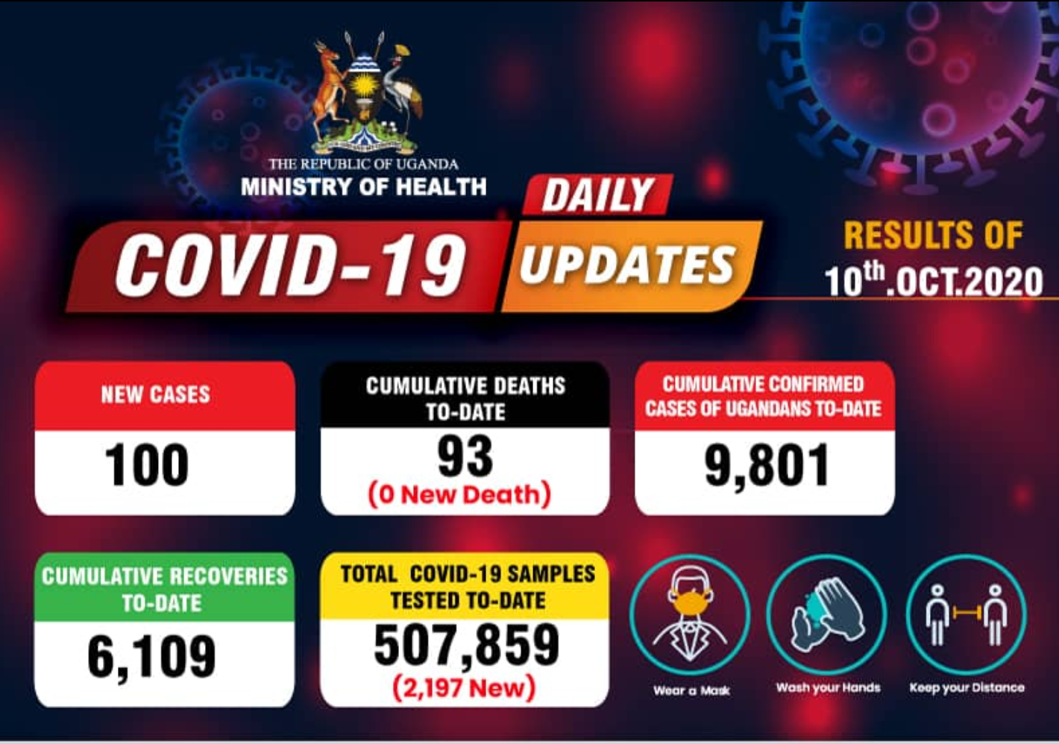
COVID-19 in Uganda
First COVID19 case identified March 21, 2020
Early COVID19 cases imported through cargo truck drivers
June 2020 – Cprogressed to WHO country level 4
Low case fatality rate 0.9%
Fairly high recovery rate 62%
0.06 tests per thousand

Slide 3

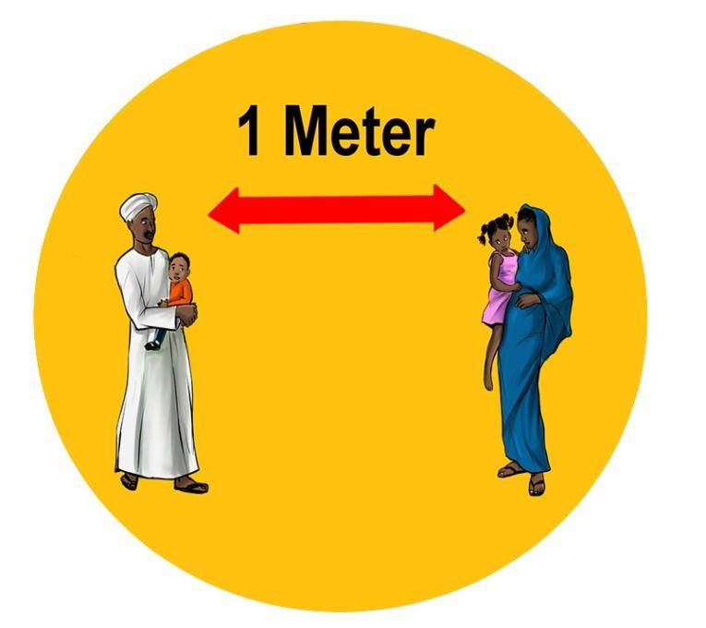
Non-pharmaceutical mitigation measures
Face masking spearheaded by government
Physical distancing key for epidemic control
Understanding cooperation is critical for effective epidemic control
Set out to understand the community perspective of COVID-19 in uganda
Harness existing data science methods
https://www.unicef.org/sudan/press-releases/physical-not-social-distancing
https://www.mtn.co.ug/

Slide 4
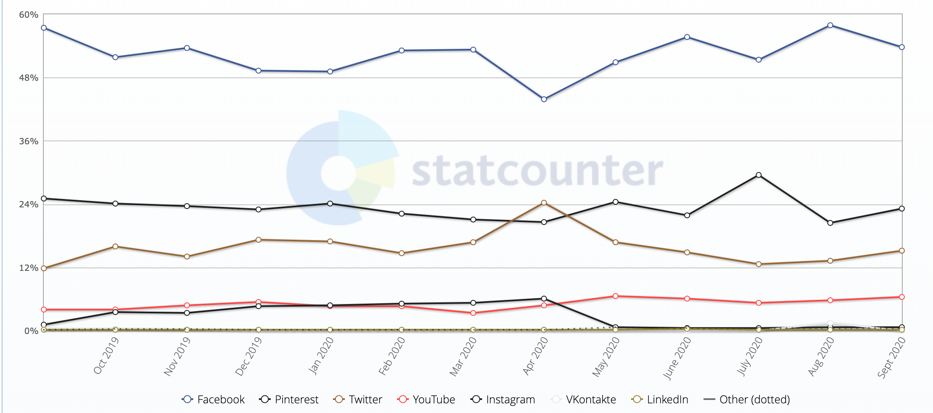
Uganda social media statistics Sep 2019 - Sep 2020
-
https://gs.statcounter.com/social-media-stats/all/uganda

Slide 5

Mining of Twitter data in Uganda
Twitter is a social media platform for sharing short-text updates
By May 30, 2020¹,
There were 330 million monthly active users
145 million daily active users on Twitter
Twitter statistics for Africa and or uganda
As increasing number of people rely on Twitter for news on COVID-19
Twitter data are real-time and a good resource for data mining and will be important resources for widespread implementation in public health applications
1. https://www.oberlo.com/blog/twitter-statistics#

Slide 6
Methods
Used Natural Language Processing (NLP) techniques to process Twitter information on COVID-19.
Tweets conversations from March 1, 2020 to date
Purchased historical Twitter data 1st March – August 27, 2020
Used the streaming API service starting from August 27, 2020 to date.
Keywords related to COVID-19 in Uganda – #COVID19UG, #COVID-UG, #COVID19_UG
The information collected was geotagged to return only information from Uganda, ie: specific Ugandan coordinates were used.
The dataset from March 1, 2020 to March 30, 2020 tentatively contains 100k unique tweets.
Sentiment analysis to identify positive and negative information.

Slide 7
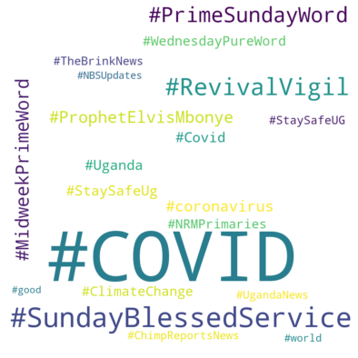
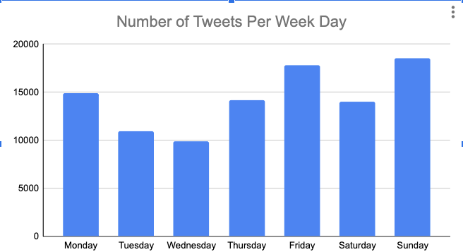
Types and days of tweets

Slide 8
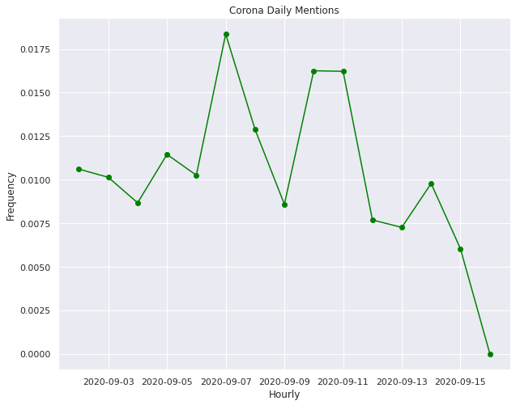
Sentiment analysis versus COVID19 cases and deaths

Slide 9
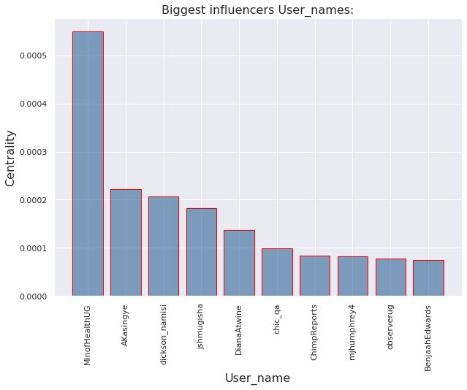
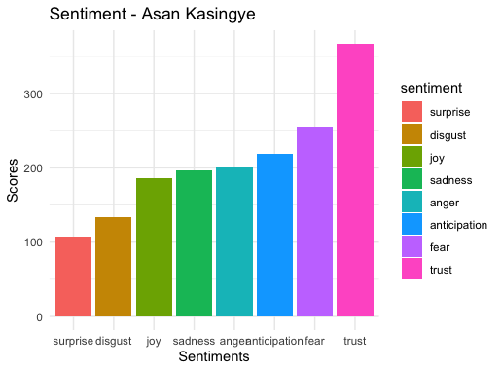
Influencers on Twitter

Slide 10
Conclusions and future steps
Data mining of Twitter data has great potential to inform public health response to COVID-19
Observed reductions in tweets over time with increasing transmission; fatigue? complacency? politics?
Religious heads central role and can be champions for infection control and promoting NPIs e.g. face masking
Identification of Twitter influencers for community campaigns
Current work
Relating tweets with COVID-19 cases and deaths
Other media data e.g. Facebook?
Improving pipelines for continuous streaming of data to capture seasonality of public health concerns

Slide 11
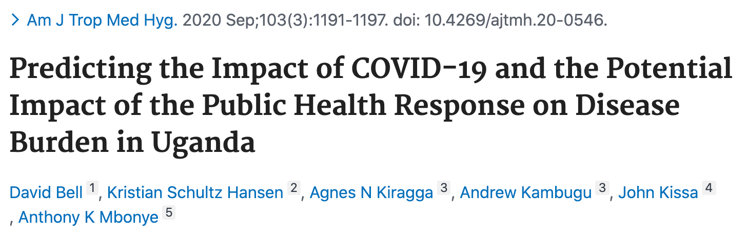
Impact of public Health response to COVID-19 on HIV

Slide 12
COVID-19 in Africa
Ongoing concerns for sub-Saharan Africa (SSA) and previous predictions of bigger epidemic with majority of persons affected
Due to – pre-existing infectious diseases, socio economic conditions and fragile health systems
Lower COVID-19 cases compared to Asia, Europe, America- 1.2M cases
Lower Case fatality rates e.g. 25K deaths compared to 580K in America¹
The impacts of COVID-19 on other diseases remains under reported
Predicted mortality and burden from COVID and impact of COV-19 public health response on other diseases in Uganda
1. Johns Hopkins University

Slide 13
Methods
Data on HIV and TB obtained from President’s Emergency Plan for Aids Relief (PEPFAR) weekly reports
DALYs lost calculated using WHO global burden of disease estimates
Life years lost by age calculated as the difference between actual age of death and the life expectancy in a standard life table and disability weights for disease severity
COVID-19 disease burden and excess HIV and TB were calculated by multiplying the DALYs lost for a single health event by the population incidence and deaths by age-group.
COVID19 DALYS based on age-related mortality by Verity et al. from the China applied to age structures of comparison countries with relatively high COVID-19 burden (e.g. Italy, USA)
Worst case 20% total detectable COVID19 infection rate was applied across all age-groups
Potential impact of reduced health service access in Uganda through the COVID19 response was predicted for HIV/AIDS and Tuberculosis
HIV/AIDS predictions assumed an arbitrarily low (20%) loss to follow-up (no medication) for current infections extending for 6 months, with mortality returning to pre-ART mortality
Reduced detection of new HIV infections and initiation of management is based on first quarter 2020 data.
Notes:
Life years lost by age calculated as the difference between actual age of death and the life expectancy in a standard life table and a set of disability weights to reflect the relative severity of diseases

Slide 14
Weekly reports on HIV indicators - April 2020ª
a. With support from the President’s Emergency Plan for AIDS Relief (PEPFAR)

Slide 15
Predicted relative mortality and DALYS from COVID
Assumed equivalent infection rate per country standardised over predicted burden from Italy
Early epidemic with limited data from Africa
Low relative mortality and DALYS from COVID

Slide 16
DALYs lost assuming a 20% infection rate of COVID-19
Age range in years | Age (in years) of death | Number of deathsª | DALYs lost
0 - 9 | 5 | 42 | 3,696
10 - 19 | 15 | 147 | 11,355
20 - 29 | 25 | 452 | 30,320
30 - 39 | 35 | 755 | 43,169
40 - 49 | 45 | 892 | 42,180
50 - 59 | 55 | 2,028 | 76,028
60 - 69 | 65 | 3,293 | 91,733
70 - 79 | 75 | 3,965 | 73,836
80+ | 85 | 3,064 | 32,783
Total |  | 14,640 | 405,100
a. Using reported deaths from China, Verity et al

Slide 17
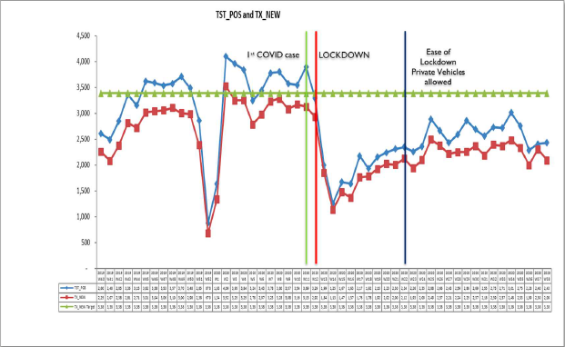
Updated Weekly report – October 2020

Slide 18
Conclusions
Get summary conclusion from any paper
Community persoective of cov 19 criticla for embracing non-pharmaceutical measures
Updated Impact of cov on other health outcomes e.g. HIV is important
Mathematical models that inform response remain critical
African governments need to embrace more data science methods for fighing covid

